Slide 1

The History of Eugene Kaspersky, I guess...
(S \ + : + / V) - face to
recognize me ;v

Slide 2
About Eugene Kaspersky:
A cybersecurity expert and a successful entrepreneur.
He began his career way back in 1989 where his computer became infected with the 'cascade' virus.
His specialized education in cryptography helped him understand its behaviour, and then develop a removal tool for it.
His curiosity and passion for computer technology drove him to start analyzing more malicious programs and developing disinfection modules of them.

Slide 3
How is this related to business !!!
These collection of antivirus modules would eventually become the foundation for Kaspersky's antivirus database.
Today, the database is one of the most comprehensive and complete collections in cybersecurity, used in detecting and preventing systems from being infected by more than 500 million malicious programs.

Slide 4
In 1997, Kaspersky was founded, with Eugene heading the company's antivirus research.
Today, Kaspersky is operating in almost 200 countries.
The company employs more than 4,000 professionals and IT security specialists in 34 dedicated regional offices across more than 30 countries.
It's cybersecurity technologies protect over 400 million users worldwide.
Competitors - Avast, Quick Heal give a chance ?
Ask – Demonstrate, further, end it ?

Slide 5

Deep diving into malwares...
Ayo I'm getting' late to school...
Guess I'll have to take a different approach... conversation
Some points to get help, I'll cover the main ones :v
Virus, Trojan, Spyware, Worms, Adware, Ransomware
Demonstration:

Slide 6
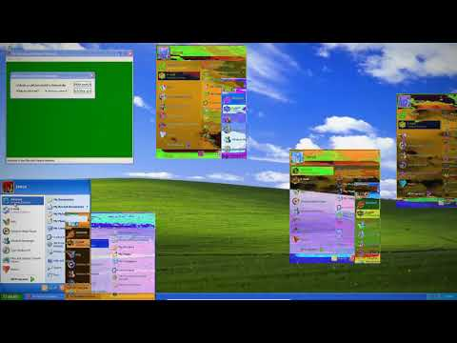

Slide 7


Peace out !
Google
GitHub, Kshitij2205
≈≈ i̢̖̝̥͒̑ͫ̄̍̃nͣ͊s̠͚̎͌ͯ̂ềr͖̬͇̫͎̙ͪt̹̞̖̦̙̙͓ͣ̐͌ͩͣ̈́ͨ ₡r͖̬͇̫͎̙ͪềA̠̟̤̤͖̘̩͞t̹̞̖̦̙̙͓ͣ̐͌ͩͣ̈́ͨiͤͣv̜̬̒ͭͬ͘ề Ḽiͤͣnͣ͊ề Ħềr͖̬͇̫͎̙ͪề ;ṽ ≈≈

